Slide 1
Cellular energy
8.1

Slide 2
Transformation of energy
Energy- the ability to do work
Thermodynamics- the study of the flow and transformation of energy. Thermodynamics have laws, like matter.

Slide 3
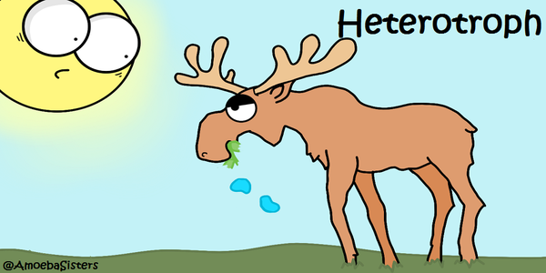
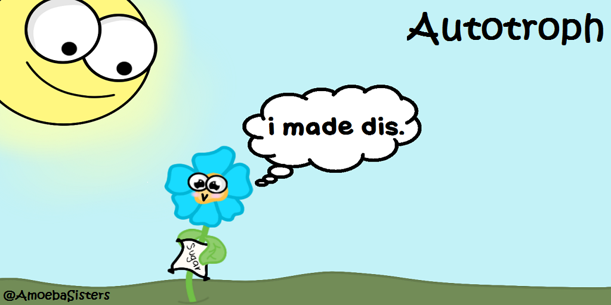
Autotrophs and heterotrophs
Q: where do heterotrophs get their energy?
A: from eating
Q: where do autotrophs get their energy?
A: from the sun.
Ultimately, all energy comes from the sun.
Organisms that convert energy from the sun are called photoautotrophs.

Slide 4
Laws of thermodynamics
First law of thermodynamics- energy cannot be created or destroyed, only transformed from one form to another. (Like matter!)
Second law of thermodynamics- energy cannot be transformed without the loss of useable energy .
Q: What do you think happens to the “Lost” energy?
A: the energy that gets “lost” is generally converted to thermal energy

Slide 5
metabolism
Metabolism- all of the chemical reactions in a cell.
There are two types of metabolic pathways.
Catabolic- breaking down molecules and releasing energy.
Ex: eating food and breaking down the nutrients in it.
Anabolic- building larger molecules out of smaller ones broken down by catabolic pathways, using the energy released by catabolic pathways.
Ex: building proteins in translation
the relationship of anabolic and catabolic pathways results in the continual flow of energy within an organism.

Slide 6
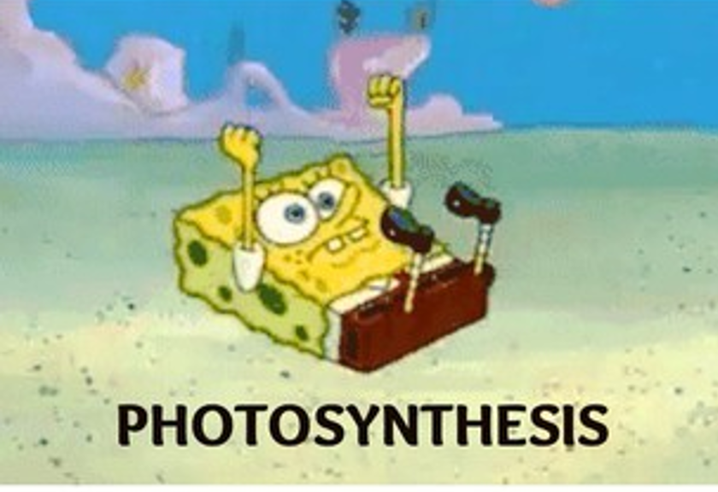
Photosynthesis
Photosynthesis- the anabolic pathway in which light energy from the Sun is converted to chemical energy for use from the cell.
In this reaction, autotrophs use light energy, CO2, and water to form glucose and oxygen.
The glucose produced from this reaction can be used for energy by the autotroph or eaten by a consumer for energy.

Slide 7
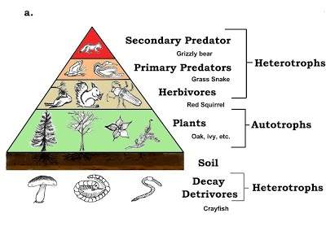
2nd law of thermodynamics
Entropy- measure of disorder, or unusable energy, in a system.
The 2nd law of thermodynamics can also be stated as, “entropy increases”.
Entropy increasing can be seen in food chains, as usable energy decreases from one trophic level to the next.

Slide 8
Cellular respiration
Cellular respiration- the catabolic pathway in which organic molecules are broken down to release energy
In this reaction, oxygen is used to break down organic molecules, resulting in the production of CO2 and water.

Slide 9
Adenosine triphosphate
Adenosine triphosphate (ATP)- a biological molecule that organisms can convert from chemical energy to mechanical energy. This nolecule is the most abundant energy-carrier molecules in cells.
Energy is produced when the bond between the second and third Phosphates are broken. This produces ADP.
Draw this
Adenosine
Ribosee
P
P
P

Slide 10
Key points
Photosynthesis and cellular respiration are different types of metabolism that work together to create oxygen and glucose from CO2 and water.

