Slide 1
Biodiversity
5.1, 5.2,5.3

Slide 2
Remember Biodiversity?
Biodiversity- variety of life in an area.
The enemy of biodiversity is extinction.
Extinction- when the last member of a species dies.
Endangered- at risk of becoming extinct

Slide 3
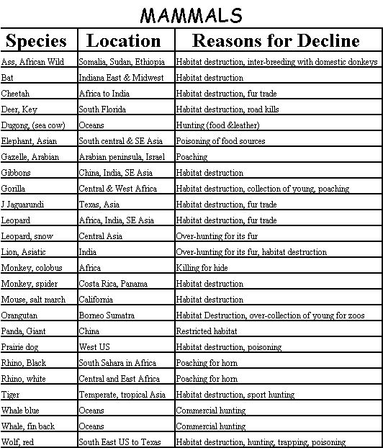
Extinction and endangerment

Slide 4
Types of Biodiversity
Genetic Diversity- the variety of genes or inheritable characteristic that are present in a population.
Ex: Humans have different genes for different hair colors, eye colors, heights, weights, etc.
Species Diversity-The number of different species and the relative abundance of each species in a biological community
Ex: Birds, Deer, Snakes, Foxes all live together in forests.

Slide 5
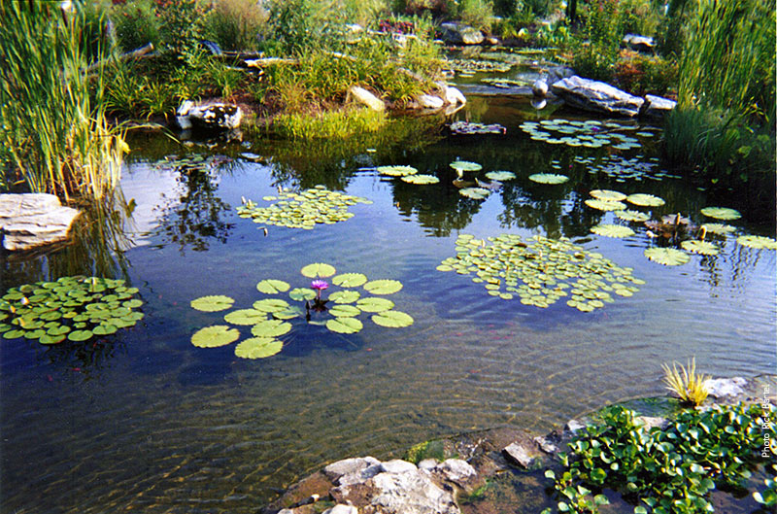
Types of Biodiversity
Ecosystem Diversity- the variety of ecosystems that are present throughout the biosphere.
Ex: Forest ecosystems, lake/pond ecosystems, desert ecosystems

Slide 6
The Importance of Biodiversity
There are a few reasons why biodiversity is imperative to sustaining life.
-Direct Economic value
-Indirect Economic value
-Aesthetic and Scientific value

Slide 7
The importance of Biodiversity
Direct economic value- Humans depend on plants and animals to provide food, clothing, energy, medicine and shelter.
Therefore, its important to conserve all of these resources.
Another reason to conserve these resources is that plants and animals have a large variety of genes that could become useful in the future.

Slide 8
The importance of Biodiversity
Indirect economic value- plants convert CO2 to Oxygen for humans and animals to breath.
Certain natural processes help filter water for drinking.
Aesthetic and Scientific Biodiversity- Variety of life in plants and animals is beautiful and natural.
Many species rely on specific rare organisms for their survival, and if biodiversity is decreased, habitats/food/other resources also decrease.
Ex: The tropical rainforest is the most biodiverse biome in the world. As rainforests decrease, so do habitats and therefore biodiversity.

Slide 9
5.2 Threats to biodiversity
Extinction
Overexploitation
Habitat loss
Fragmentation of habitat
Pollution
Introduced species

Slide 10
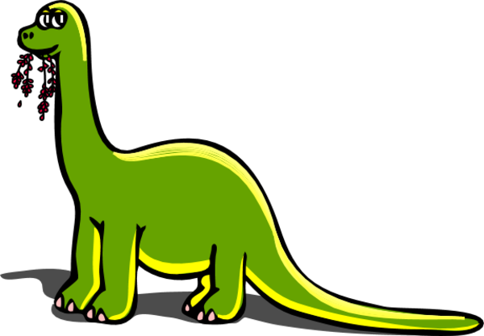
Extinction
Extinction is the loss of a species in its entirety.
Some species will go extinct naturally through background extinction.
Other species go extinct through lack of care/ lack of conservation. This is mass extinction.

Slide 11
Mass Extinction
Species can be massively extinct by a couple of different ways.
Overexploitation- excessive use of a species that have economic value.
Ex: animal furs, elephant tusks, rhinoceros horns, certain fish are often overfished like salmon/tuna.
Habitat loss- clearing out specific areas of land due to their desirable resources or living space.
Ex: clearing out tropical rainforests to harvest lumber.

Slide 12
Mass Extinction
Habitat Disruption- when one organism in a food web is over represented or under represented, the rest of the food web is thrown off.
Ex: certain fish are over fished, creating a trophic cascade.
Habitat fragmentation- the separation of an ecosystem into small pieces of land.
Ex: a highway in between two forest areas.

Slide 13
Other threats to Biodiversity
Pollution- changes in the composition in air, water, and soil.
Pesticides are a common form of pollution that, when ingested by organisms, can decrease biodiversity.
Acid rain- the mixture of fossil fuel fumes with precipitation to degrade calcium, potassium, and other nutrients from plants and soil.

Slide 14
Other threats to biodiversity
Introduced species- transporting non-native species to a habitat.
This can cause a habitat disruption and possibly extinction of species.
Ex: A fire ants species was introduced to the US in Alabama by accident. These ants spread across the south east and would feed on certain types of wild-life.

Slide 15
5.3 Conserving Biodiversity
Methods of conserving biodiversity include
Using renewable resources instead of nonrenewable
Using and creating more sustainable resources
Respecting nationally protected areas
Creating corridors to protect fragmented habitats
Restoring destroyed ecosystems

Slide 16
Key points for 5.1,5.2,5.3
Biodiversity is imperative to sustaining human life
There are many threats to biodiversity, some of these are in our control, others are not
It’s important to take steps to sustain biodiversity throughout the biosphere

