Slide 1
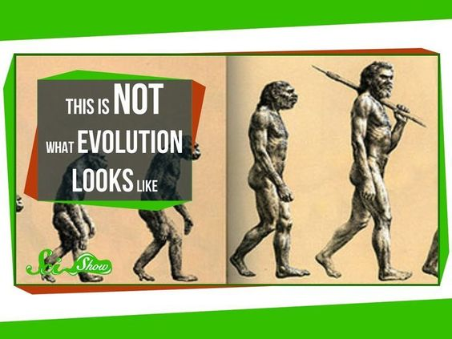
Fossil Evidence of Change
14.1

Slide 2
Earth’s early history
Land environments- by studying other plants, scientists have concluded that the Earth was formed about 4.6 Billion years ago, and it was a molten body while it was being formed. The earliest clues about life on Earth date to about 3.5 billion years ago.
Atomsphere- the gases that likely made up the Earth’s early atmosphere were from volcanoes. Atmosphere today is made up of H2O, CO2, SO2, CO, H2S, HCN, and N2.

Slide 3
Clues in Rocks
The fossil record
A fossil is any preserved evidence of an organism.
Plants, animals, and bacteria can form fossils.
Most organisms decompose before they have a chance to fossilize, only organisms that are buried deep and rapidly will fossilize. (ex: something buried via avalanche, flood, etc.)
Paleontologists study fossils in rocks

Slide 4
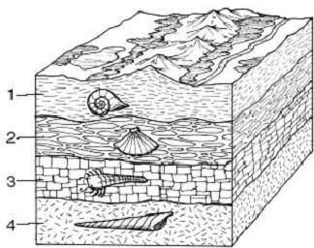
Fossil record
Fossils will typically form in sedimentary (layered) rocks. Because the heat and pressure involved in making metamorphic and igneous rocks isn’t suitable for fossil formation.

Slide 5
Fossil record
Dating fossils
Relative dating- a method used to determine the age of rocks by comparing them with those in other layers.
The law of superposition- this law states that younger layers of rocks are deposited on top of older layers.
Radiometric dating- a fossil dating method that uses the decay of radioactive isotopes to measure the age of a rock.
Isotope- an element with the same atomic number but with a different mass number.

Slide 6
Geologic time scale
Geologic-time scale- record of Earth’s history.

Slide 7
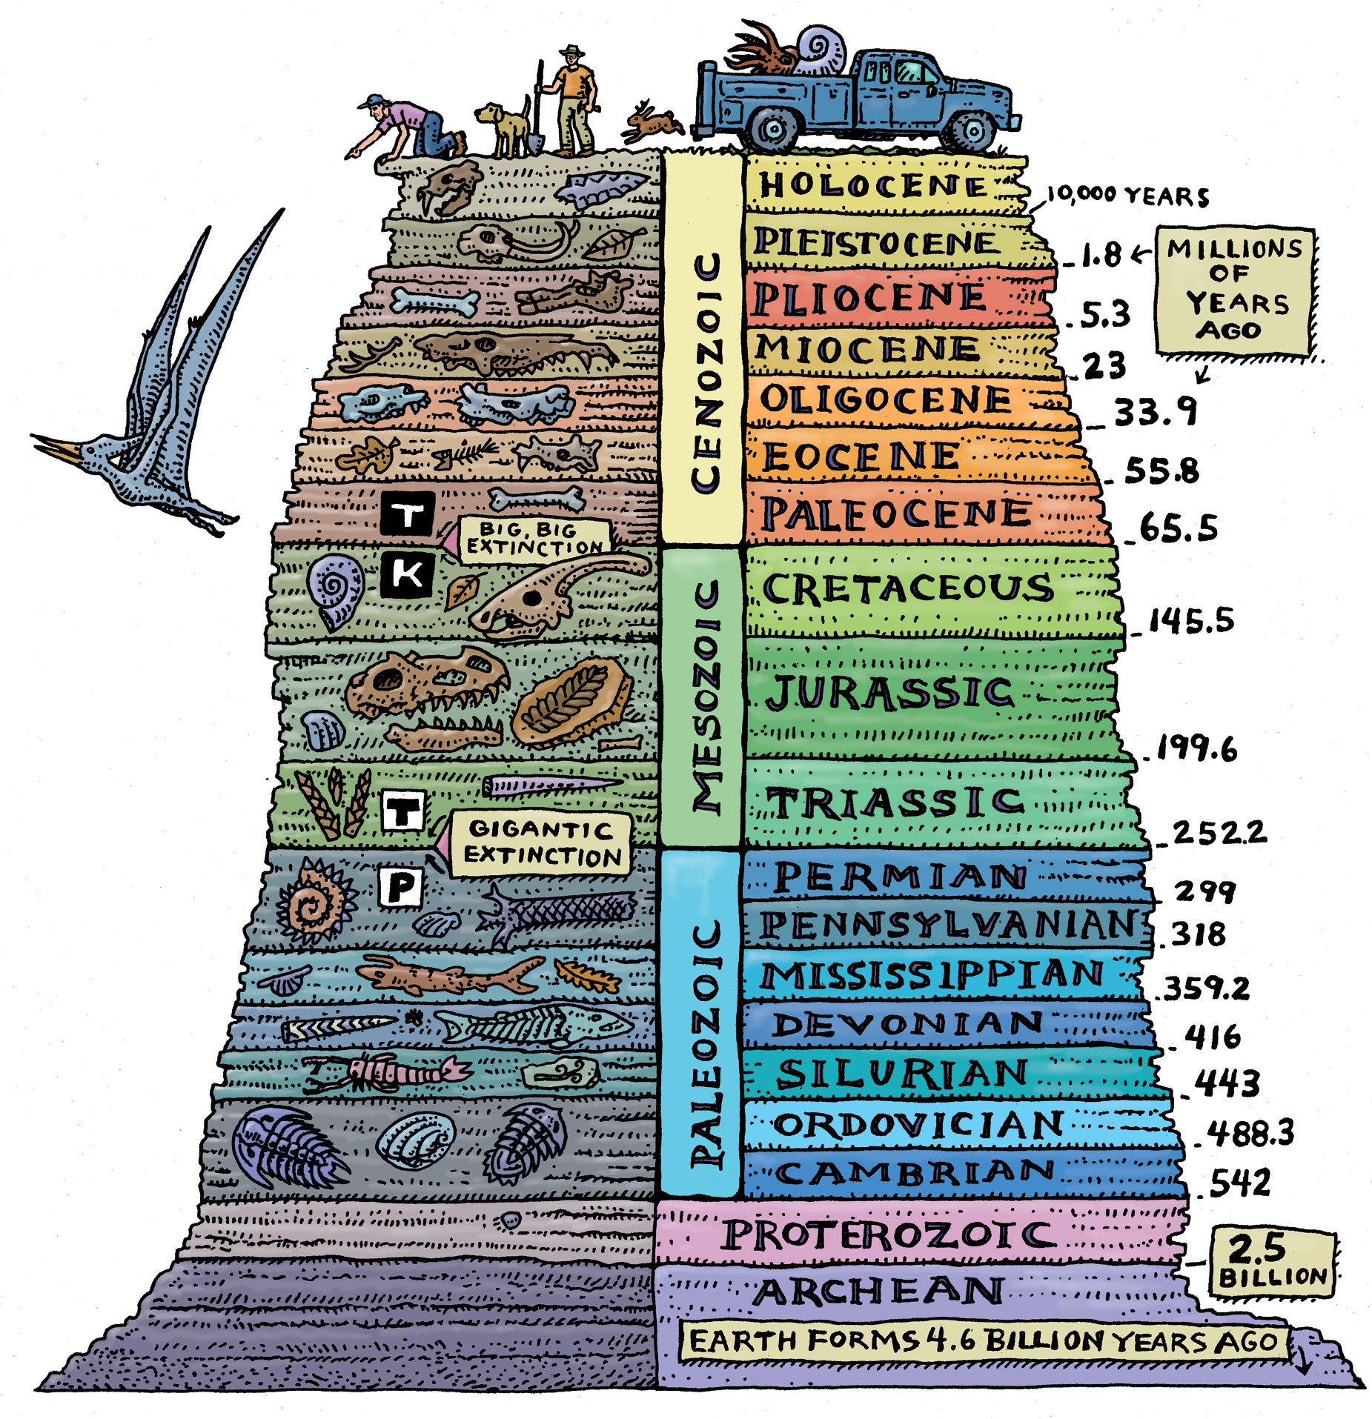

Slide 8
Geologic Time Scale
The geologic time scale is broken down into sub categories.
Epoch- smallest unit of geologic time (several million years)
Period- unit of geologic time (tens of millions of years)
Era- unit of geologic time, two or more periods (hundreds of millions of years)

Slide 9
Geologic time scale
Precambrian- nearly 90% of the Earth’s entire history. Stretching from the formation of Earth to the beginning of the Paleozoic era about 542 Mill. Years ago.
Made up of tonian, cryogeian, and ediacaran periods
Earth is formed
Eukaryotic cells and prokaryotic cells emerge here
Invertebrates and algae diversify
Soft-bodied organisms appear

Slide 10
Geologic time scale
Paleozoic era- this era is marked by a drastic change in the history of animal life on Earth.
Made up of the Cambrian, Ordovician, Silurian, Devonian, carboniferous, and Permian periods.
In the space of just a few million years, the ancestors of most major animal groups diversified in what scientists call the Cambrian Explosion.
First plants appear here
Sharks/bony fish appear
Amphibians appear
Ferns/ evergreens appear to make forests

Slide 11
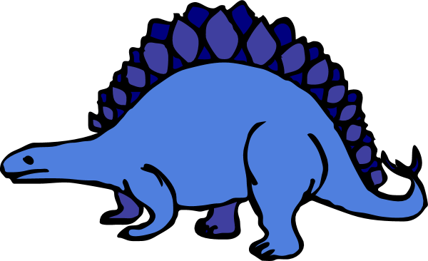
Geologic time scale
Mesozoic era- evidence (meteorite rocks) for a meteorite wiping out the dinosaurs appears during this era, these rocks are found between the land layers which were formed between the cretaceous period and the Paleogene period of the next era. This layer is called the K-T boundary.
* Please note that the meteorite was not responsible for wiping out dinosaurs, but the debris left in the atmosphere made their habitat inhospitable and dinosaurs slowly became extinct via background extinction.
This era is made up of the Triassic, Jurassic, and cretaceous periods.
First mammals appear here
Dinosaurs appear
Forests become lush
First birds appear
Flowering plants appear
Dinosaur population peaks

Slide 12
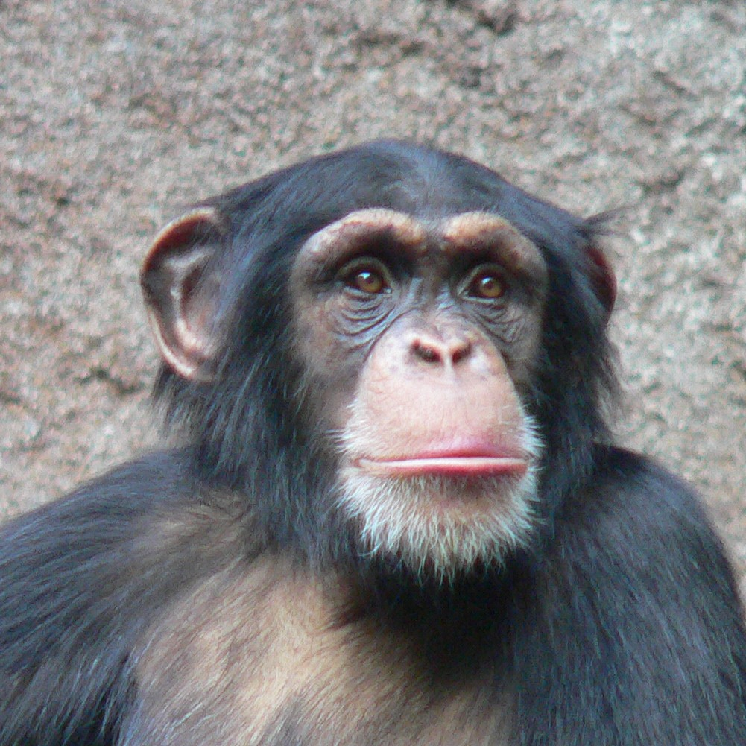
Geologic time scale
Cenozoic era- this era was heavily influenced by plate tectonics; this era if the most recent in which mammals dominate land animals.
Plate tectonics describes the movement of several large plates that make up the surface of the earth.
Made up of the Paleogene and Neogene periods and 7 different epochs.
Most mammals come into existence
Monkeys appear
Apes appear
Humans form civilization

Slide 13
Key points
There is evidence in fossils for change throughout the history of the Earth.

