Slide 1
Dna: The genetic material
12.1

Slide 2
What is dna
Remember nucleic acids? They’re biological molecules like lipids, carbs, and proteins.
DNA stands for deoxyribonucleic acid.
Deoxy- because an oxygen has been taken away
Ribo- because there is a ribose sugar present
Nucleic acid- because nucleic acids are present.
https://www.youtube.com/watch?v=zwibgNGe4aY&t=1s

Slide 3
Why is dna important?
DNA contains all of the genetic information that determines every single thing about you.
It is often referred to as the blue print for life.
Your DNA determines all of your outer, physical appearances as well as how your body works.
If DNA gets damaged, there can be major consequences.
Damaged DNA is called a mutation.

Slide 4
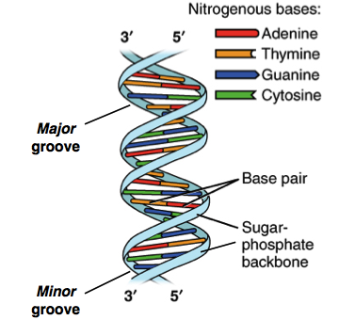
What does dna look like?
The structure of DNA is called the double helix.
This is due to the two sided spiral that forms the DNA

Slide 5
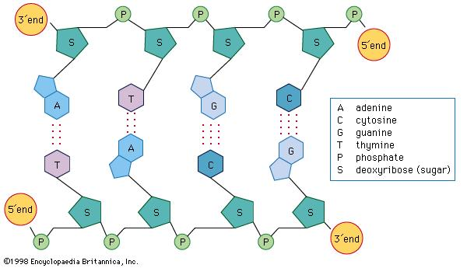
What is dna made of?
DNA is composed of ribose sugars, phosphates, and nucleic acids.
The sugar and the phosphates form what is called the backbone (the sugar-phosphate backbone)
Two backbones are joined together by the nitrogenous bases.
There are 4 nitrogenous bases, cytosine, thymine, adenine, and guanine.

Slide 6
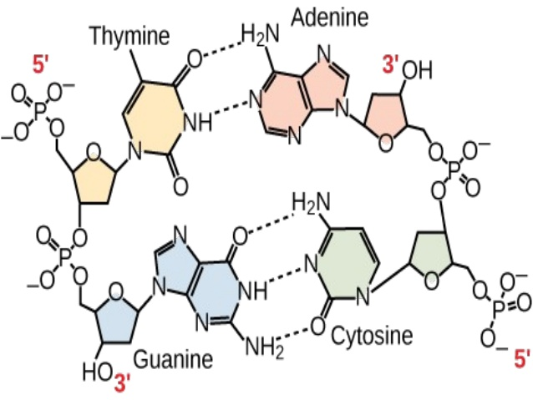
What is dna made of?
The nitrogenous bases are held together by hydrogen bonds which are very weak.
Thymine ALWAYS bonds with Adenine.
Because A and T each only have 2 places to bind, so they bind to each other.
Guanine ALWAYS bonds with Cytosine.
Because G and C each only have 3 places to bind, so they always bind together.

Slide 7
What is dna made of?
Guanine and adenine are the same type of base, called purines.
Cytosine and thymine are the same type, called pyrimidines.
Uracil is a based only used in protein production and is found in RNA ONLY.
Uracil binds with adenine in Thymine’s place while making RNA.
Thymine cannot ever ever ever ever ever ever be in RNA.

Slide 8
Key points for 12.1
DNA is what makes you look, act, and operate the way you do.
DNA is in the double helix shape.
DNA is made up of sugar, phosphate, and nitrogenous bases
A PAIRS WITH T AND G PAIRS WITH C
A WITH T , G WITH C
AT
GC
AT GC
AT GC AT GC

