Slide 1
Chromosomes and Human Heredity
11.3

Slide 2
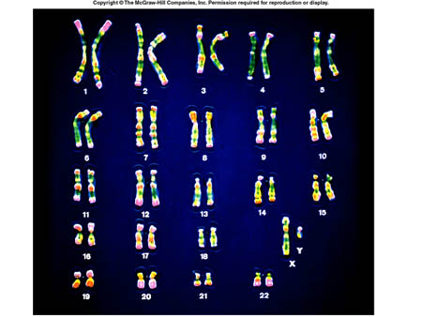
Karyotype studies
A karyotype is a diagram that shows all of the chromosomes that an organism has.
Every colored bar on the chromsomes are different genes
Notice how the chromosomes get smaller as you move towards the 22nd chromsome

Slide 3
Karyotype studies
Humans have 23 pairs of chromosomes- 46 individual chromosomes
The 23rd pair of chromosomes are the sex chromosomes
The 23rd pair of chromosomes will either be an XY pair or an XX pair
Females XX and males XY

Slide 4
Karyotype studies
Side B is from the other parent
The pairs of chromosomes, when lined up with the chromosome that has the same kinds of genes (when it is with the chromosome that looks just like itself)
They’re called homologous chromosomes
Homologous chromosomes- chromosomes that have the same types of genes on them, but not necessarily the same alleles for those genes
Side A is from one parent

Slide 5
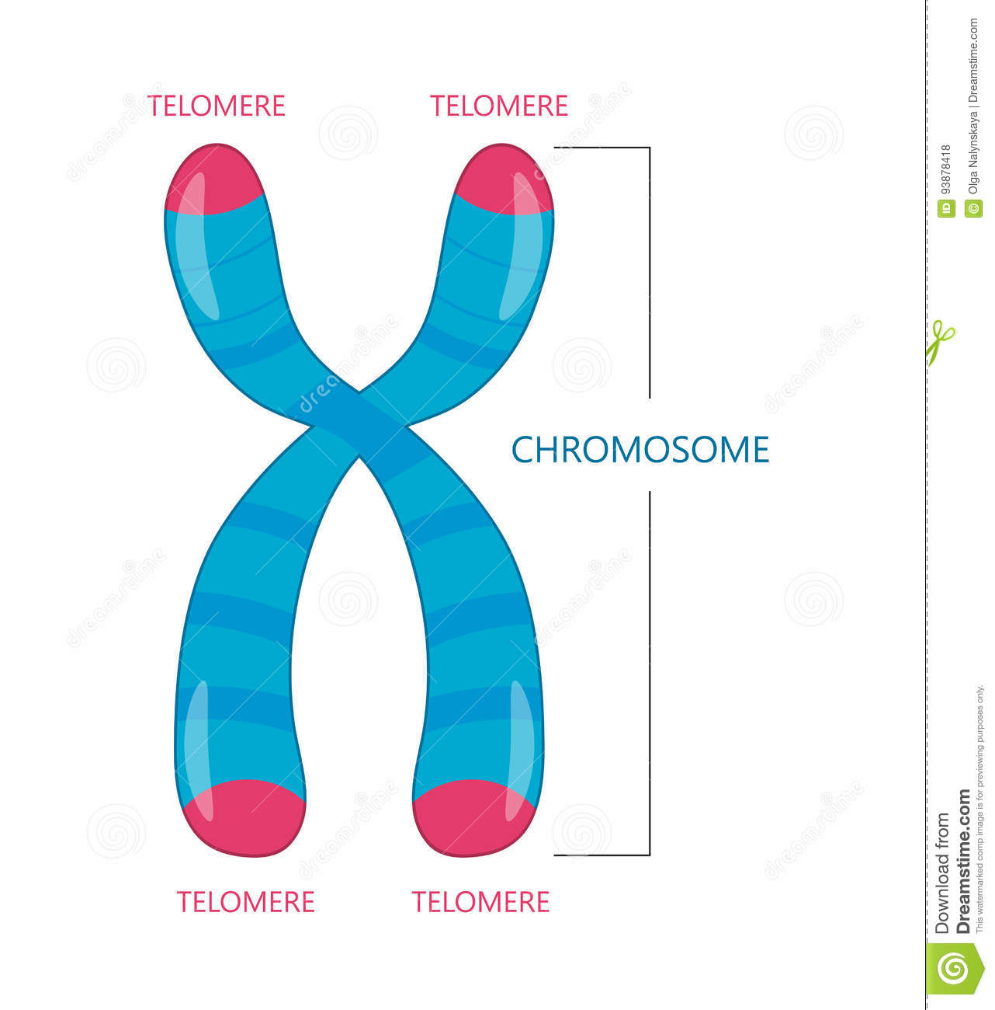
Chromosomes
Telomere- protective end cap of a chromosome.
Telomere are important because everytime chromosomes divide during mitosis or meiosis, it risks breakage and loss of DNA
Telomeres protect the DNA

Slide 6
Chromosomes
During Meiosis and Mitosis, there’s always the possibility that chromosomes won’t divide properly. When this happens, it’s called nondisjunction.

Slide 7
Chromosomes
Remember, that all of the cells that result from Meiosis have the potential to be fertilized and become a baby.
What do you think might become of the baby that results from either of the two cells that have been circled?

Slide 8
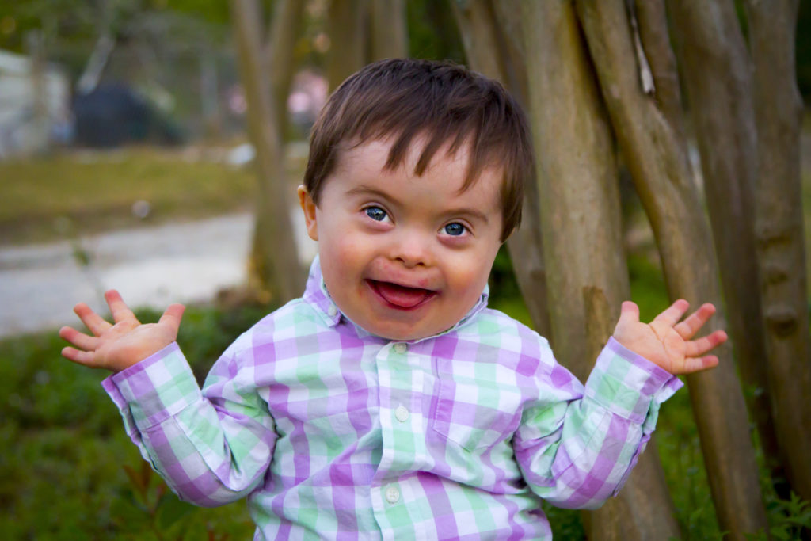
Genetic Diseases
When nondisjunction occurs and those cells are fertilized, if the zygote survives to become a fetus and then a baby, that baby will most likely have a genetic disorder.
Ex. Down’s Syndrome, Klinefelter’s, Patau Syndrome

Slide 9
Genetic Diseases
There are certain types of tests that can be performed on pregnant women to see if their baby is at risk for these nondisjunction diseases.
https://www.youtube.com/watch?v=oeR4jGNCnd4
Prenatal testing is good and bad. Good because it can inform you of health issues to expect with your baby. Also bad because you may discover that your baby is very unhealthy and you may have to face serious medical decisions for yourself and your baby.

Slide 10
Key points for 11.3
Humans have 23 chromosomes, as can be seen in a karyotype.
The 23rd chromosomes in humans determine the biological sex (XX for women and XY for men)
Nondisjunction is when chromosomes don’t properly divide during Mitosis or meiosis.

