Slide 1
Complex Patterns of Inheritance
11.2

Slide 2
Remember basic patterns of inheritance
If a disease is carried on a recessive allele, the genotype must be homozygous recessive (bb) to express the disease.
If a disease is carried on a dominant allele, the genotype can be either homozygous dominant (BB) or heterozygous (Bb) to express it
If an organism has the genotype Bb for a recessive genetic disorder, they are called a carrier for the disease, meaning they have the disease but they don’t express it
They only carry it and can give it away but they do not have it.

Slide 3
Complex patterns of inheritance
There are patterns of inheritance that don’t follow the basic rules- they have their own set of rules.
Incomplete dominant
Codominance
Multiple alleles
Sex determination
Sex linked traits

Slide 4
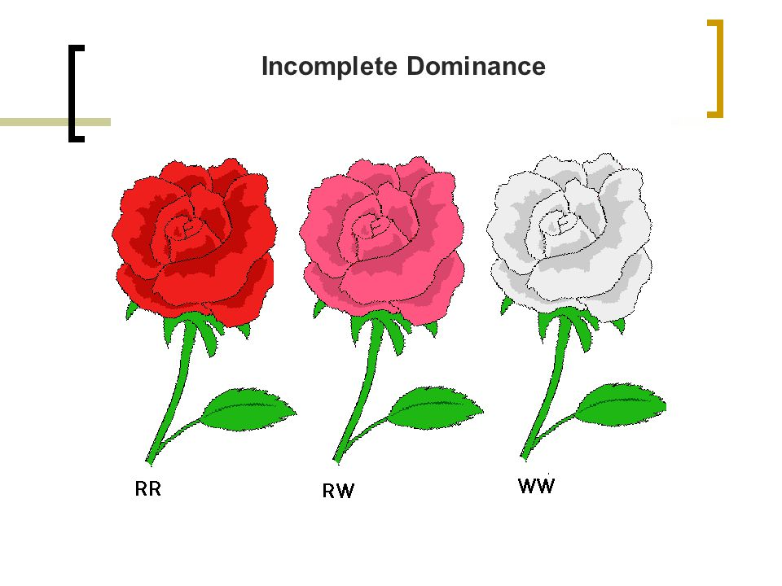
Incomplete dominance
In incomplete dominance, there are two dominant alleles
In incomplete dominance, the heterozygous genotype DOES NOT result in one dominant phenotype or the other.
The heterozygous genotype results in a MIXED PHENOTYPE between the dominant phenotype and the recessive phenotype.

Slide 5
Incomplete Dominance
Think of incomplete dominance as a compromise between the phenotypes.
EX: I want pizza hut, my husband wants taco bell Where can we eat dinner that we both get what we want to eat but we don’t get the restaurant we want?
NOTE: A PUNNETT SQUARE/PEDIGREE WILL ONLY BE INCOMPLETE DOMINANT IF YOU ARE TOLD SO

Slide 6
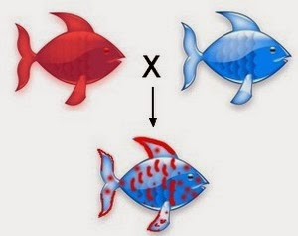
Codominance
In incomplete dominance, there are two dominant alleles
In incomplete dominance, the heterozygous genotype DOES NOT result in one dominant phenotype or the other.
When two dominant alleles are present in codominance, BOTH ARE EQUALLY EXPRESSED.

Slide 7
Codominance
Think of codominance are combining, but not mixing.
EX: I want pizza hut, my husband wants taco bell Where can we eat dinner that we both get what we want to eat AND get to eat at the restaurant we want?
NOTE: A PUNNETT SQUARE/PEDIGREE WILL ONLY BE CODOMINANT IF YOU ARE TOLD SO

Slide 8
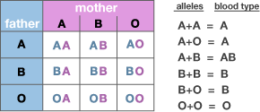
Multiple alleles
Some forms of inheritance are determined by more than two alleles.
EX: Blood types. Alleles for blood types are IA, IB, and II.
You can be A blood type (IA IA) ( IA II) , AB blood type (IA IB) , B blood type (B IB) (IB I), or O blood type (II)

Slide 9
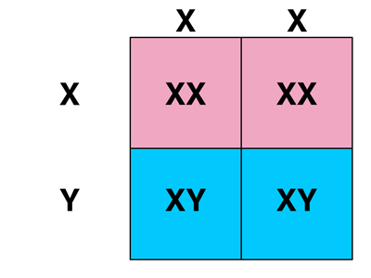
Sex Determination
The biological sex of an organism is determined by their sex chromosomes.
Male= XY
Female= XX
An organism’s biological gender is determined by which alleles they received from their parents.

Slide 10
Sex chromosomes
Sex chromosomes are different from regular body chromosomes.
Sex chromosomes have two jobs- determine your gender and pass on your genetic information to your offspring
Regular body chromosomes determine your hair color, eye color, organ function, etc.
They’re also known as Autosomes
Autosomes have a lot of jobs (like telling your body what to do and what to look like)

Slide 11
Sex linked traits
Certain traits only travel on genes that are found on sex chromosomes.
The genes found on sex chromosomes are those that biologically make you a male or female.
There are some traits that affect things other than gender such as the ability to see color.

Slide 12
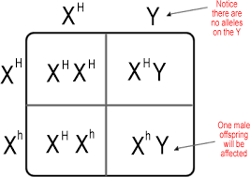
Sex linked traits
Color blindness is a sex-linked trait.
It is recessive and travels on the x chromosome.
If a male gets the recessive X, he will have color blindness.
Females have to have two recessive x’s to be color blind.

Slide 13
Key points for 11.2
Inheritance isn’t always as simple as dominant and recessive
REMEMBER--- CODOMINANCE IS TACO HUT
INCOMPLETE DOMINANCE IS GOLDEN CORRALL

