Slide 1
11.1 Basic Patterns of Human Inheritance

Slide 2
Recessive Genetic disorders
Remember, if there is ever a dominant trait present, the recessive trait will not show.
So, if there is a genetic disorder that travels on a recessive allele, it won’t show
It will be covered up by the dominant allele, which is normally healthy. This will make the organism healthy.
The healthy organism that doesn’t show the recessive disorder but still has it is called a CARRIER.

Slide 3
Recessive Genetic disorders
Since an organism would have to have 2 recessive alleles for the recessive disorder to show, it is very rare to have a recessive genetic disorder.
It is, however, common to be heterozygous ( AKA a carrier) for a recessive disease.

Slide 4
Dominant Genetic Disorders
Remember, only one allele has to be dominant for the dominant genotype to show through.
So, if a dominant allele carries a genetic disorder, an organism only has to have one dominant allele to have the disorder.

Slide 5
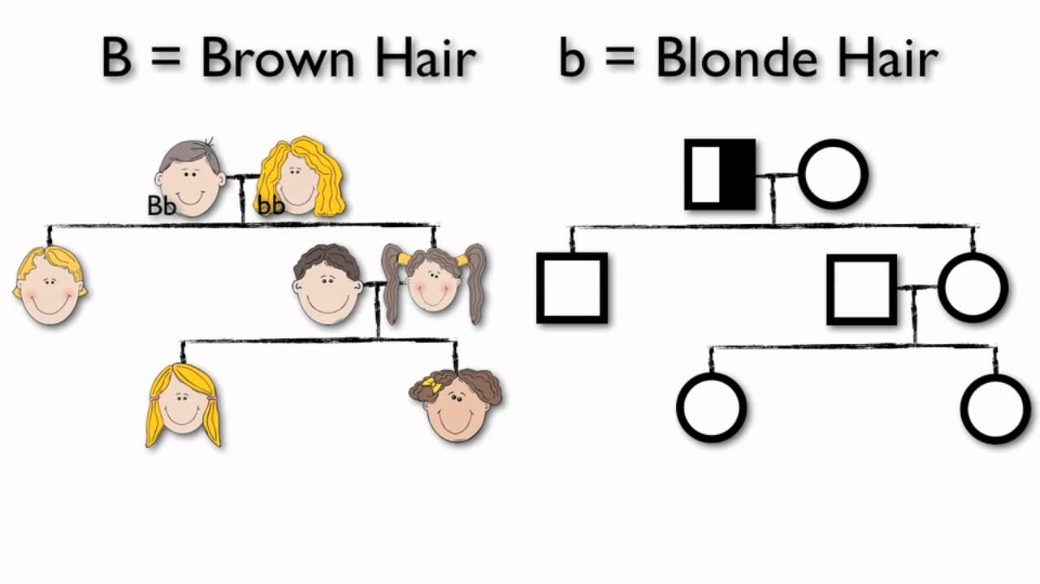
Pedigrees
A pedigree is a diagram that traces the inheritance of a particular trait through several generations.

Slide 6
Pedigrees
Pedigrees are used to figure out genotype information from phenotypes.
Pedigrees are really useful for tracing genetic diseases through families to see what traits have been passed on to what offspring
https://www.youtube.com/watch?v=Wuk0W10EveU

Slide 7
Key points for 11.1
Someone with the genotype Bb is a carrier for whatever trait b is, but they do not show it.
Pedigrees are charts to help trace the passing on of traits from parents to offspring.

