Slide 1
Mendelian Genetics
10.2

Slide 2
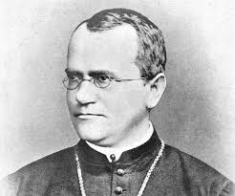
Gregor Mendel
Genetics- the science of heredity
Heredity- the passing on of physical or mental characteristics genetically from one generation to another.
Gregor Mendel was an Austrian Monk who is called the father of Genetics due to his extensive work studying heredity.

Slide 3
Gregor Mendel
Mendel worked with pea plants to do his research.
Mendel crossed (bred) a yellow pea with a green pea. These peas would be called the P generation, or Parent generation.
All of the peas that resulted from the P cross (green and yellow) were yellow.
The results from the P generation are called the F1 generation, for the first fertilization.

Slide 4
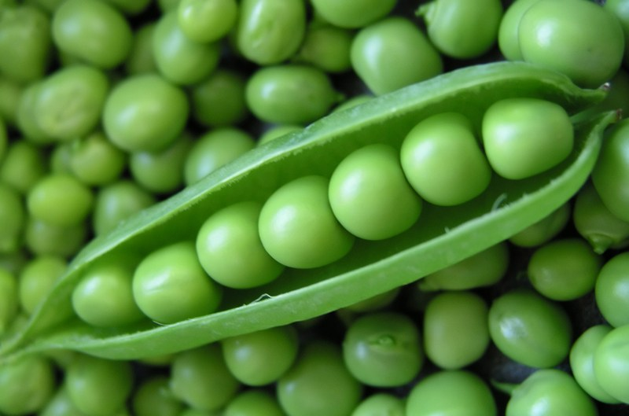
Gregor Mendel
Mendel allowed all of the yellow peas from the F1 generation to fertilize each other.
All of the peas that resulted from the F1 generation self-fertilizing were referred to as the F2 generation, for the second fertilization.
For every 3 yellow peas in the F2 generation, there was 1 green pea.

Slide 5
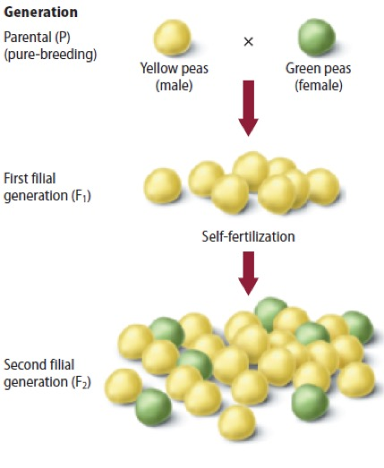
Gregor Mendel

Slide 6
Gregor Mendel
By completing this cross and hundreds more, Mendel came to a few conclusions.
First, the color trait of the peas (green or yellow) is called an allele.
Allele- alternative form of a single gene passed from generation to generation. (pronounced uh-l-eel)
Mendel concluded that there are two or more alleles for every trait.
Trait- characteristic of an organisms such as hair color or eye color.

Slide 7
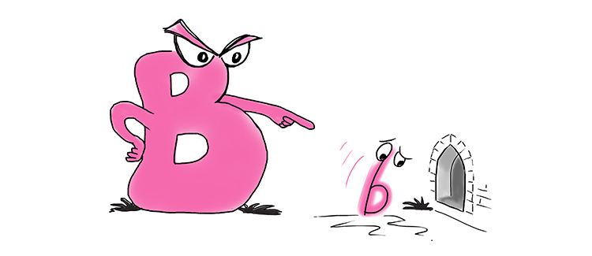
Gregor Mendel
Mendel also concluded that traits are either recessive or dominant. He concluded that genes can carry 2 alleles, recessive and/or dominant.
Recessive- weaker version of an allele, will be covered up or overridden if a dominant allele is present. These alleles were not shown in Mendel’s F1 generation of pea plants, but showed up in the F2 generation being the 1 in the 3:1 ratio. Denoted with a lower case letter. Ex. t
Dominant- stronger version of an allele, will always be expressed if at least 1 is present. These alleles were expressed in the F1 generation and the F2 generation, being the 3 in the 3:1 ration. Denoted with an uppercase letter, ex. T

Slide 8
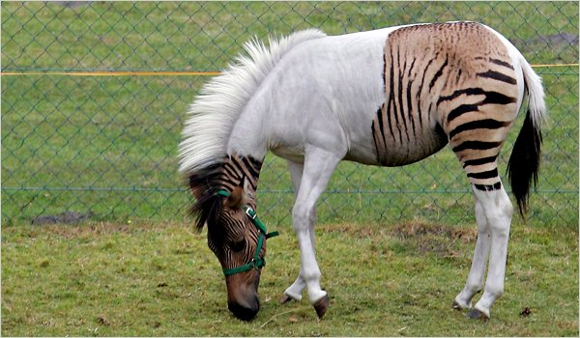
Heredity
When the alleles that an organism has for a gene are a dominant AND a recessive allele, that organism is referred to as HETEROZYGOUS for that gene. Also referred to as HYBRID .Ex. Tt
When the alleles that an organisms has for a genes are dominant and dominant or recessive and recessive, that organism is referred to as HOMOZYGOUS dominant or HOMOZYGOUS recessive for that gene. Also referred to as PUREBRED. Ex. TT or tt
Homo- means the same
Hetero- means different

Slide 9
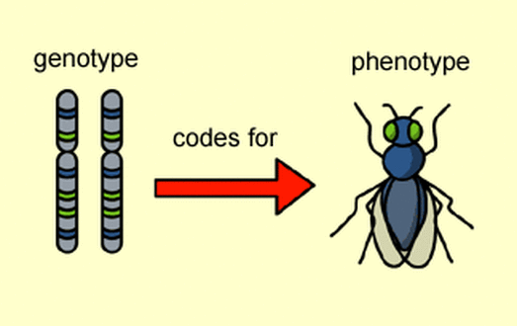
Heredity
The alleles that an organism has for a gene is referred to as the genotype. Ex. The genotype I have for eye color is Tt, meaning I have a dominant allele and a lower case allele. This genotype can be referred to as heterozygous.
The genotype is not visible, it can only be assumed based off of the physical appearance.

Slide 10
Heredity
The physical expression of a genotype is called the phenotype.
Ex. My genotype for eye color is Tt, which makes my eye color brown, because the allele for brown eyes is T, which is dominant.
You CAN see the phenotype with the naked eye. Ex. You can see that I have brown hair.
Note: If an organism physically expresses a phenotype that is caused by a homozygous recessive genotype, we can know that their genotype is homozygous recessive.
Ex. Blonde hair is a recessive allele, and if someone has blonde hair, you can know that their genotype is tt or homozygous recessive for hair color.

Slide 11
Gregor Mendel
One of Mendel’s largest contributions to Genetics is his Law of Segregation.
Law of segregation- states that two alleles for each trait separate during meiosis. Meaning that T goes to one gamete and t goes to another gamete.
This is how you don’t end up looking identical to a sibling for a certain trait, because you only get one trait from mom and one trait from dad for every gene.

Slide 13
Gregor Mendel
Another one of Mendel’s contributions was the law of independent assortment.
Law of independent assortment- states that single alleles are randomly distributed during meiosis. Genes of separate chromosomes sort independently during Meiosis. This law also contributes to diversity among siblings.

Slide 14
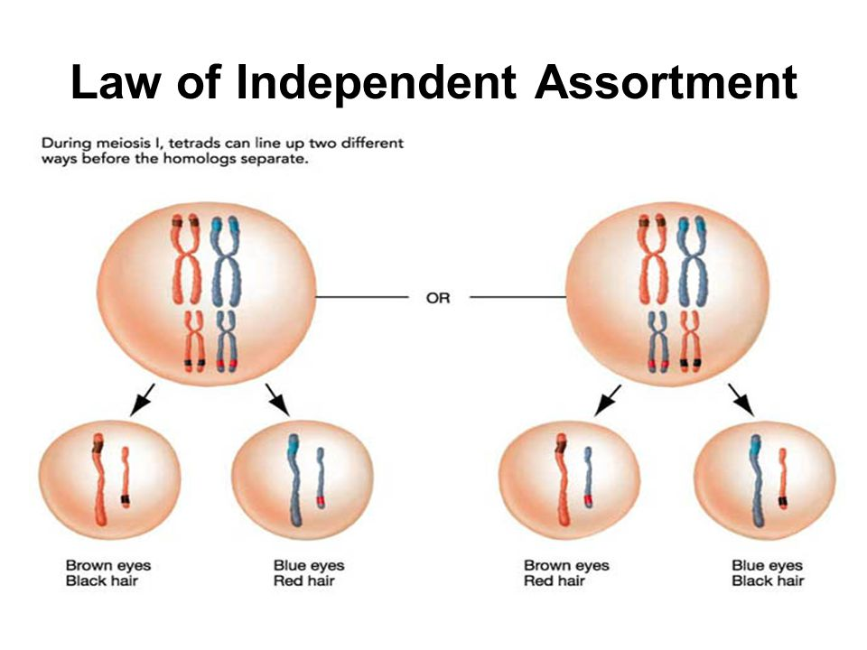

Slide 15
Punnett Squares
A Punnett square is a graphing method used to combine genotypes and figure the probability of genotypes in an offspring based off of the parents.
There are two different types of Punnett squares
Monohybrid- mono means one, this type of Punnett square crosses the alleles for one trait. You will be working with two letters here, but they will be the same letter. Ex. (TT, Tt, tt) Same letter, different sizes.
Dihybrid- di means two, this type of Punnett square crosses the alleles for two traits. You will be working with 4 letters here, two of the same letter.
Ex. (Ttyy, TtYY, ttYy, etc.) different letters, different sizes.

Slide 16
Probability
The inheritance of genes can be compared to the probability of flipping a coin.
The probability of the coin landing on heads is 1 out of 2, or ½.
If the same coin is flipped twice, the probability of it landing on heads is ½ each time or ½ X 1/2 , or ¼ both times.

Slide 17
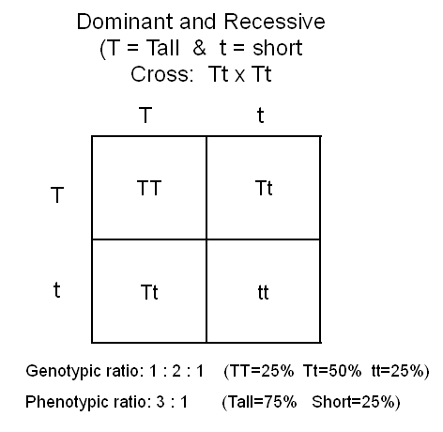
Punnett Squares
Monohybrid Cross Tutorial

Slide 18
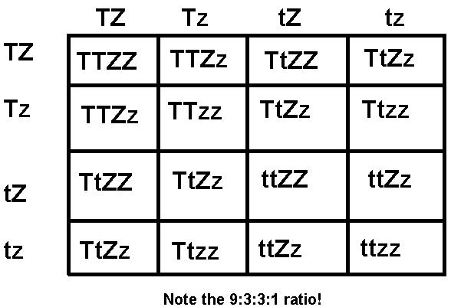
Punnett Squares
Dihybrid Cross Tutorial

Slide 19
Key points for 10.2
There are at least two alleles for every trait
These alleles can either be dominant or recessive and are passed down to offspring independently of one another.

